Slide 1

Rethinking Overtime
Implications of Increased Overtime Exemption Thresholds
February 1, 2016

Slide 2
Agenda
Agenda
Introduction
Objectives
basics of the Overtime Exemption Rule
Proposed Rule Change
Assumptions
Outcomes
Implications
Recap

Slide 3
INTRODUCTION
INTRODUCTION
The Department of Labor’s Wage and Hour Division (DOL) has proposed new regulations to the overtime pay rules under the Fair Labor Standards Act (FLSA).
The new regulations are designed to expand the number of workers eligible to receive overtime pay through an increase in the salary threshold for the executive, administrative and professional (EAP) exemption, a.k.a. ‘white collar’ exemption. The rule also outlines a method for increasing the threshold annually.
DOL anticipates that in the first year the new rule will affect 4.6 million currently exempt workers who earn less than the proposed new threshold of $50,440. Others put the estimate much higher.

Slide 4
Objectives
Objectives of the presentation
Provide overview of proposed changes to the rule;
Illustrate how employers are likely to respond;
Highlight some specific issues associated with the design and outcomes of the proposed rule.

Slide 5
The Basics of the Overtime Rule
The basics
How the rule works at the moment…
FLSA establishes that workers are generally entitled to overtime pay unless they qualify for an exemption.
FLSA sets three statutory requirements to be considered exempt from overtime under the white collar exemption:
Salary basis test: paid a pre-determined fixed salary.
Salary level test: must meet minimum specified amount—currently set at $455/week.
Duties test: must primarily involve executive, administrative or professional duties.

Slide 6
The Basics of the Overtime Rule
The basics
And the changes that are proposed…
In July 2015, DOL issued a proposed overtime rule that would more than double the minimum salary threshold in 2016 and automatically increase the level every year thereafter.
Current
Must earn $455 per week ($23,660 a year).
This salary level is fixed until rule is revised.
Must also pass duties and salary basis.
Proposed
Must earn $970 per week ($50,440 a year).
This salary level is adjusted annually based on CPI-U or 40th percentile of FT salaried employees.
Duties test remains as is?

Slide 7
Assumptions
Missing DOL Assumptions
DOL’s proposed rules do not adequately take into account how employers are likely to react, in particular businesses that are:
  Highly competitive, price sensitive industries → cannot easily absorb higher labor costs;
  Industries that have a tiered managerial structure and broad task/duty requirements (e.g. with many types of supervisory roles);
  Non-profit and public sector employers operate on fixed budgets and will not be able to passively absorb increased labor costs.
DOL’s proposed rules also do not adequately take into account that employers have options for alternative compensation structures that they are likely to use rather than simply to pay more in labor costs—overtime or higher salaries.

Slide 8
Assumptions
Oxford Economics’ Baseline Assumption
For-profit businesses in highly competitive markets, specifically retail and chain restaurants, report little wiggle room to adjust the price of products upward, even in the face of rising costs.
To remain competitive and profitable in the long run, employers will use a variety of strategies to reduce labor costs that the proposed rule would seek to impose.
Notes:
Under this baseline assumption, predictable actions by employers and outcomes can be described and quantified. The key guiding principle is: employers are operating in competitive markets with a low marginal revenue structure AND these employers are profit-seeking in their business activities (i.e. they are not non-profits and intend to generate net positive returns in the long-run).

Slide 9
Outcomes
Outcomes of Proposed Changes
What will happen to workers:
In the face of increased labor costs spurred by external regulation, employers are likely to adopt different strategies to manage these costs.
Three likely strategies are:
  Compensation tradeoff
  Convert exempt, salaried → non-exempt, hourly
  Reduced hours

Slide 10
Outcomes
Outcomes of Proposed Changes
Compensation trade-off:
  Employers increase the salaries of workers near threshold to tip them over it, but other benefits are traded off to compensate
Currently exempt workers just below the $970/wk threshold will likely see their salaries increased.
However, bonuses, merit-based pay and other benefits will likely be adjusted to offset the increased cost.
In the retail and restaurant industry, for example, some 5% of the 2.2 million affected workers would likely see this outcome.

Slide 11
Outcomes
Outcomes of Proposed Changes
Convert EAP salary workers to hourly, non exempt:
  Employers convert EAP salary workers to an hourly rate, set at a level that accounts for overtime that was previously exempt.
Currently-exempt workers well below the $970/wk threshold can expect to be converted from salaried to hourly, and become overtime eligible.
They can expect this to be at a level where their compensation (including overtime) is adjusted to mitigate an overall increase in wage bill.
Retail and restaurant industry: 21% of the 2.2 million affected workers would likely see this outcome = $11,600 increase in overtime, but little to no real income gain.
Notes:
To mitigate risk of EAP duties test violation, senior and general managers would likely absorb some of the responsibilities of first-line supervisors. This would ultimately widen the wage and career gap between senior managers who are exempt, salaried workers (and eligible for bonuses, etc.) from entry-level/front-line supervisors who would be paid hourly and have lower likelihood of now receiving bonuses.

Slide 12
Outcomes
Outcomes of Proposed Changes
Reduced hours:
  Employers reduce the hours of EAP workers well under $970/week and substitute with part-time labor.
Some currently exempt workers well below the $970/week threshold will likely be converted from salaried to hourly status and have their hours reduced to less than 40 per week (to minimize risk of overtime) and compensation reduced proportionally.
Part-time labor hired to offset losses in productivity.
In the retail and restaurant industry: 11% of the 2.2 million affected workers would have hours reduced and lose $2.3 billion in wages—used to hire approximately 117,100 part-time workers.
Notes:
Considered a transfer model approach, reducing hours of productive workers to offset rising wage cost, will open the door to hire part-time workers to fill the productivity gap. However, this outcome comes at the expense of middle-income wages and further polarizes the compensation structure of workforce.

Slide 13
Implications
Implications of Proposed Changes
Middle management (and middle class) squeeze:
Those in the middle, between $455/wk and $970/wk will likely be pushed toward non-exempt (hourly). This step back in careers will result in:
  The loss of exempt perks, such as: workplace flexibility, training opportunities, benefits, and management ‘prestige’;
  Becoming time-clock mandated and closely monitored; and
  Means they are effectively ‘demoted’.
The consequence → increased polarization of exempt vs. non-exempt as middle management is hollowed out.
Fewer middle management = restricted career path options and a more hierarchical workplace.
Fewer opportunities for millennials exiting college:
Career-path opportunities erode in many industries that employ a variety of college-educated workers as salaried employees.

Slide 14
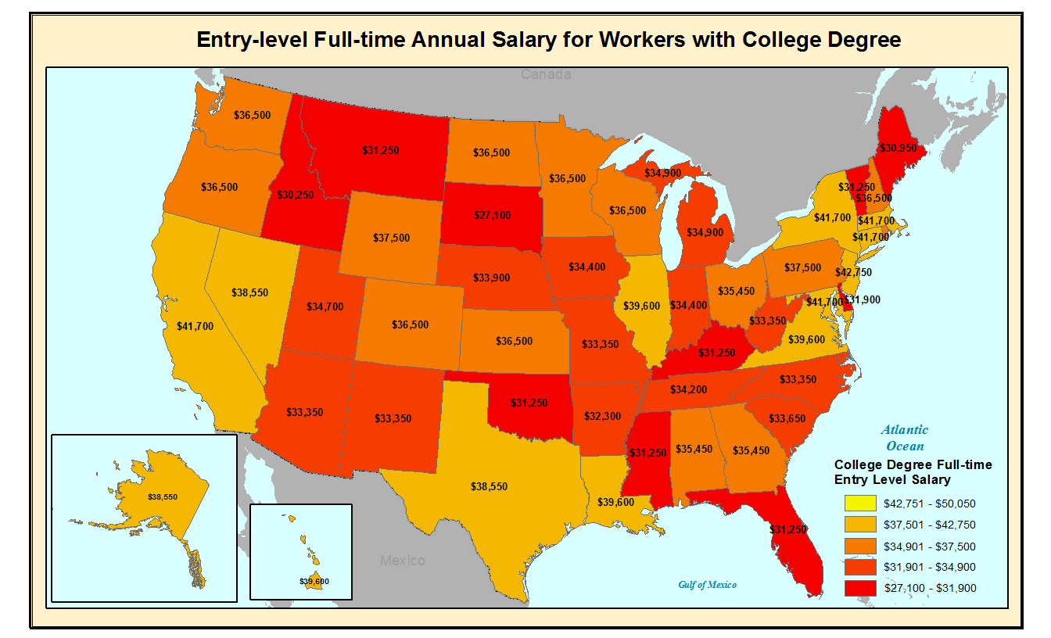
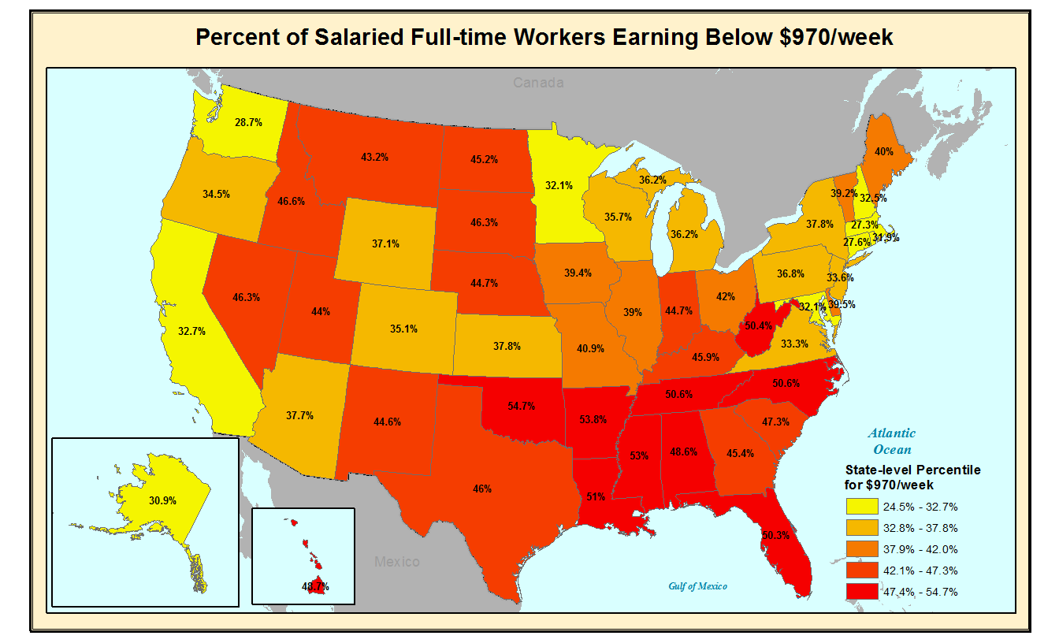
Implications
Implications of Proposed Changes
Consequences will be geographically-differentiated:
Notes:
Salaried workers in states with lower wages will more likely be affected.
Higher proportions of workers in the SE will likely be subject to adverse employment and compensation outcomes.
Relative wages are much lower in some areas than others, and much lower than the proposed national cutoff of $50,440/year.

Slide 15
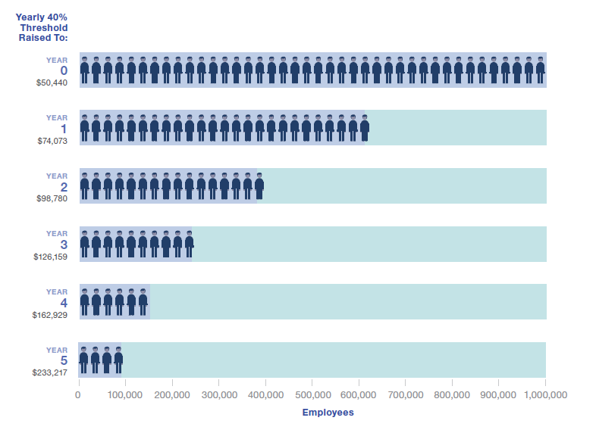
Implications
Implications of Proposed Changes
Annual adjustments to threshold—a cautionary tale:
Proposal 1:Pegging to 40th percentile would change the pool of 40th percentile workers.
Problems:
Change the pool of 40th percentile workers every year;
Risks creating a vicious cycle by compounding growth in 40th percentile earnings;
Forces employers to adjust more workers into non-exempt each year.
Source: WorldatWork
Notes:
Employers will have to weigh the increased moving target of EAP exemption against a non-exempt hourly structure

Slide 16
Implications
Implications of Proposed Changes
Annual adjustments to threshold:
Proposal 2: Pegging adjustment to inflation (CPI-U)
Problem: Inflation moves at different rates → leaves adjustment unpredictable year-over-year.

Slide 17
Recap
Recap and Key Takeaways
Employers will seek to minimize the impact on their wage costs: compensation trade-off, convert EAP to hourly, reduced hours.
Hollows out middle management opportunities.
Erodes career pathway opportunities—especially for millennials.
Affects Southeast and other low-cost states more.
Pegging the threshold to a percentile of salaried wages risks creating vicious cycle of compounding increases.
Undermines the very intent of the proposed change in the first place.

Slide 18

Earlier work
Rethinking Overtime: How increasing overtime Exemption thresholds will affect the retail and chain restaurant industries
For more information: https://nrf.com/resources/retail-library/rethinking-overtime
All data shown in tables and charts is Oxford Economics’ own data and is copyright © Oxford Economics Ltd, except where otherwise stated and cited in footnotes.
The modeling and results presented here are based on information provided by third parties, upon which Oxford Economics has relied in producing its report and forecasts in good faith. Any subsequent revision or update of those data will affect the assessments and projections shown.

Slide 19
Q & A
Questions and Answers

Slide 20


Europe, Middle East, and Africa:
Global headquarters
Oxford Economics Ltd
Abbey House
121 St Aldates
Oxford, OX1 1HB
UK
Tel: +44 (0)1865 268900
London
Broadwall House
21 Broadwall
London, SE1 9PL
UK
Tel: +44 (0)20 7803 1418
Belfast
Lagan House
Sackville Street
Lisburn
County Down, BT27 4AB
Tel: + 44 (0)2892 635400
Paarl
12 Cecilia Street
Paarl 7646
South Africa
Tel: +27(0)21 863-6200
Frankfurt
Mainzer Landstraße 41
60329 Frankfurt am Main
Germany
Tel: +49 69 95 925 280
Paris
25 rue Tiphaine
75015 Paris
France
Tel: +33 (0)1 56 53 98 52
Milan
Via Cadorna 3
20080 Albairate (MI)
Italy
Tel: +39 02 9406 1054
Americas:
New York
5 Hanover Square, 19th Floor
New York, NY 10004
USA
Tel: +1 (646) 786 1879
Philadelphia
303 West Lancaster Avenue
Suite 2e
Wayne, PA 19087
USA
Tel: +1 (610) 995 9600
Mexico City
Emerson 150, Despacho 802
Col. Polanco, Miguel Hidalgo
México D.F., C.P. 11560
Tel: +52 (55) 52503252
Boston
51 Sawyer Rd
Building 2 - Suite 220
Waltham, MA 02453
USA
Tel: +1 (617) 206 6112
Chicago
980 N. Michigan Avenue, Suite 1412 Chicago
Illinois, IL 60611
USA
Tel: +1 (773) 372-5762
Miami
8201 Peters Road
Suite 1000,
Plantation, FL 33324
USA
Tel: +1 (954) 916 5373
San Francisco
Tel: +1 (415) 870-5744
Asia Pacific:
Singapore
Singapore Land Tower
37th Floor
50 Raffles Place
Singapore 048623
Tel: +65 6829 7198
Hong Kong
30/F, Suite 3112
Entertainment Building
30 Queen’s Road Central
Hong Kong
Tel: +852 3103 1097
Sydney
Level 4, 95 Pitt Street
Sydney, 2000
Australia
Tel: +61 (0)2 8249 8286
Email:
mailbox@oxfordeconomics.com
Website:
www.oxfordeconomics.com

